Slide 1


Having an EEG
Social Narrative
© 2024 The Regents of the University of California, Davis campus. All Rights Reserved. Used with permission.

Slide 2

A note to caregivers:
This social narrative has been written to help you and your child prepare for your child’s EEG study. Social Narratives are
clearly written stories that paint a picture of a situation, event or activity. They can be used to increase understanding of a specific situation and help children prepare ahead of time.
This social narrative was written for patients of different ages and language levels. Please use language your child is familiar with at home or when visiting a doctor.
Read this first and choose what information you think will be helpful. Reviewing this with your child before your visit is helpful for many children. However, you may decide that a social narrative is not the best way to prepare your child. You know your child best.
If you decide the social narrative provides too much information and your child would do better with a visual schedule, please feel free to use the picture schedule that was also sent to you.
This story will go over the steps of completing an EEG study. We encourage you to use affirmations and positive feedback during their procedure to let them know they are doing a great job with a difficult task.
If your child may have difficulty waiting/checking in, please let our team know during your intake call so our team can make a plan to support you and your child upon your arrival.
Sincerely,
The UC Davis Health PATH Program Team
© 2024 The Regents of the University of California, Davis campus. All Rights Reserved. Used with permission.

Slide 3
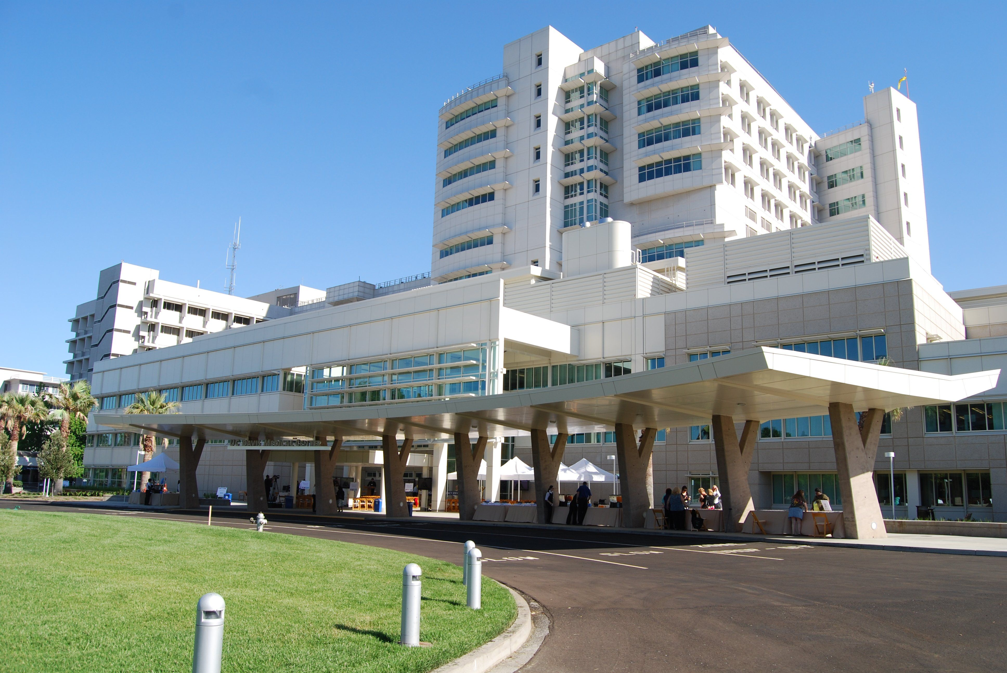
I am going to visit the UC Davis Children’s Hospital.
The doctors want to learn more about my brain while I am there.
© 2024 The Regents of the University of California, Davis campus. All Rights Reserved. Used with permission.

Slide 4
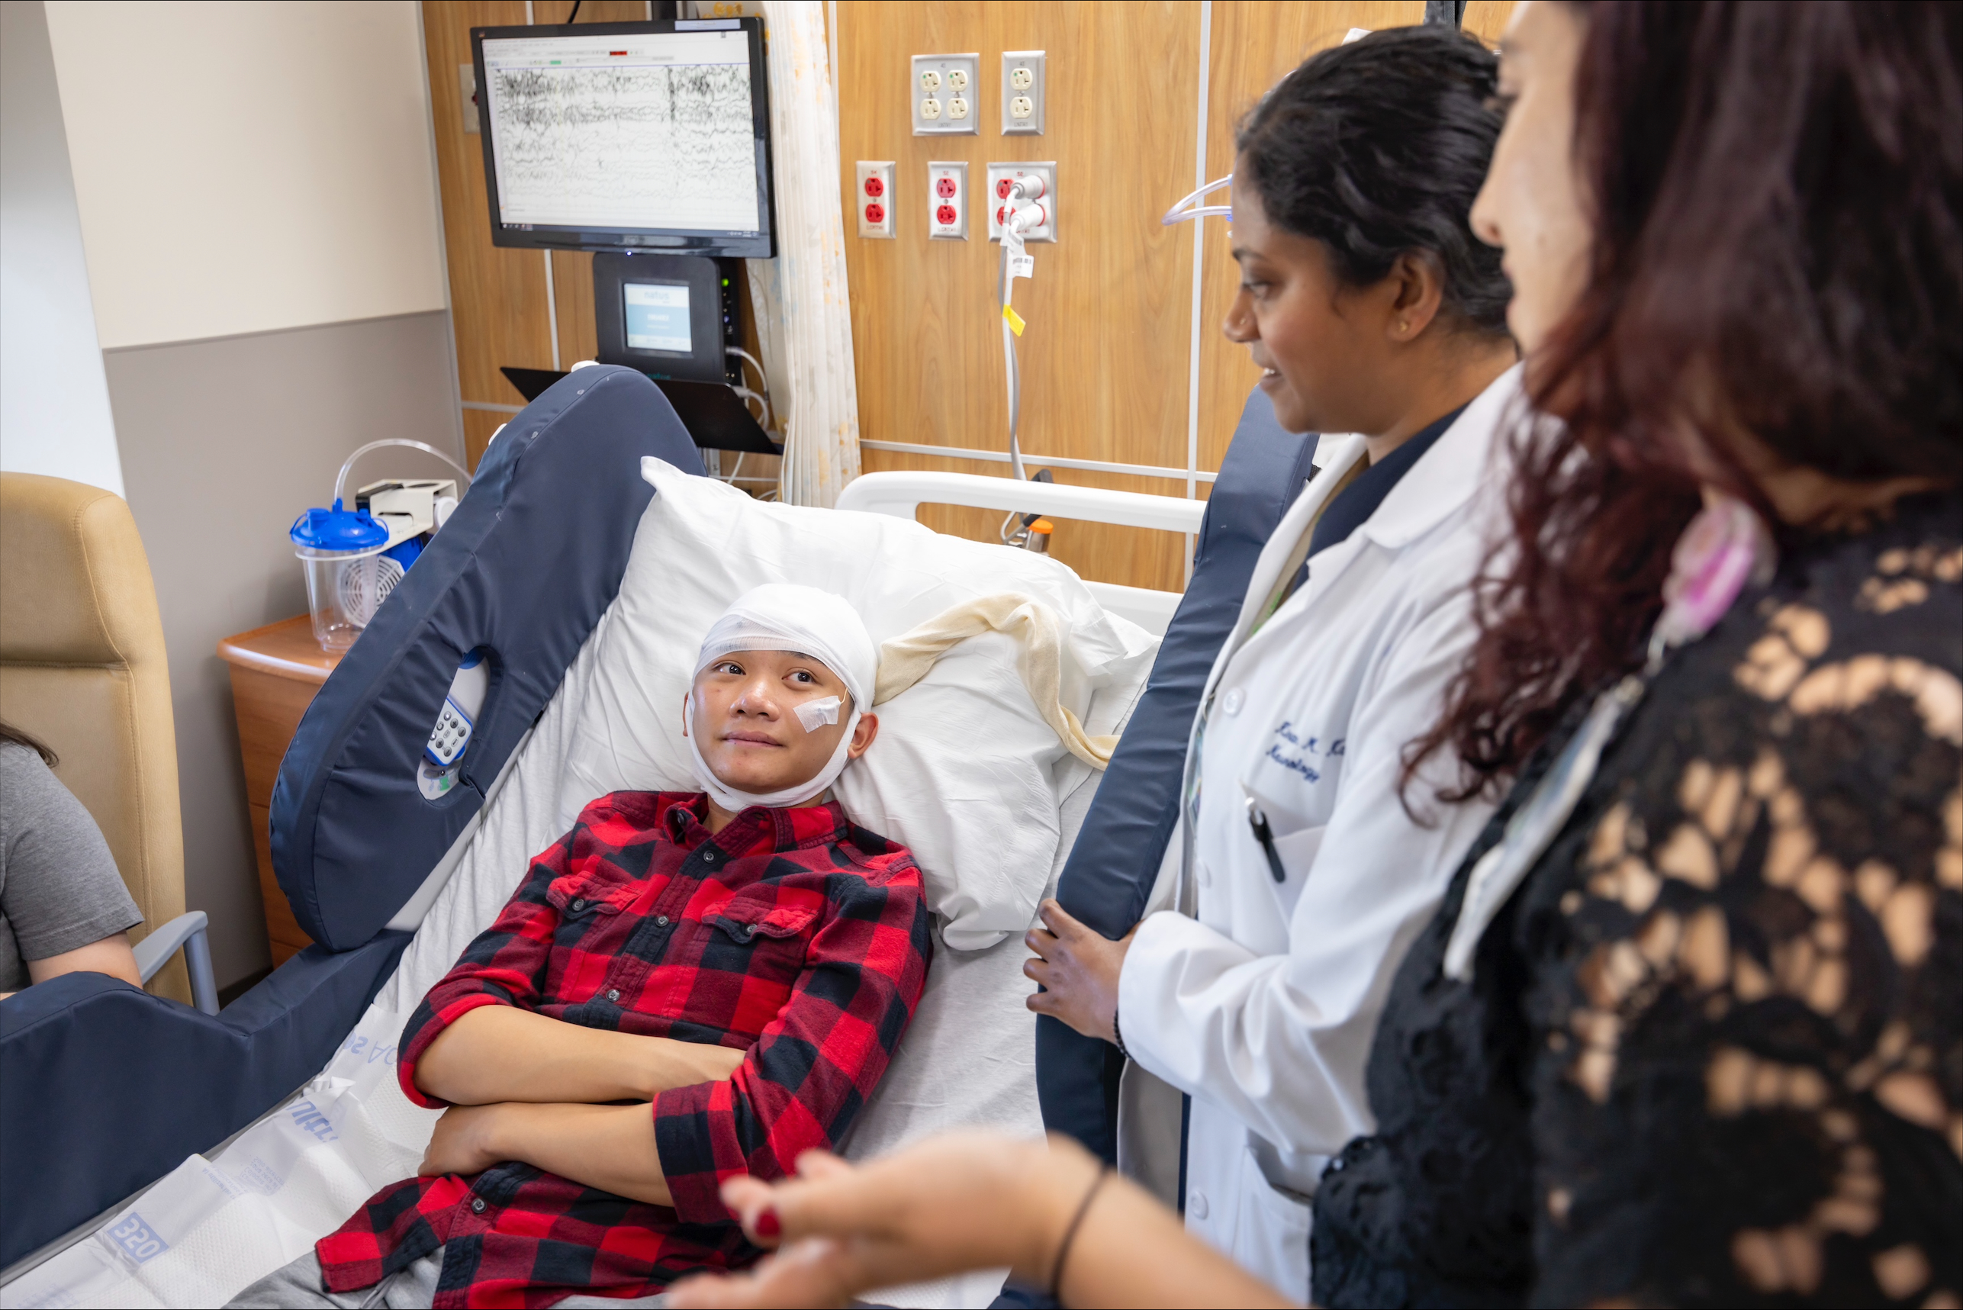
I am having an EEG.
An EEG is a test that measures brain waves, through small stickers called “electrodes” that are placed on the head.
© 2024 The Regents of the University of California, Davis campus. All Rights Reserved. Used with permission.

Slide 5
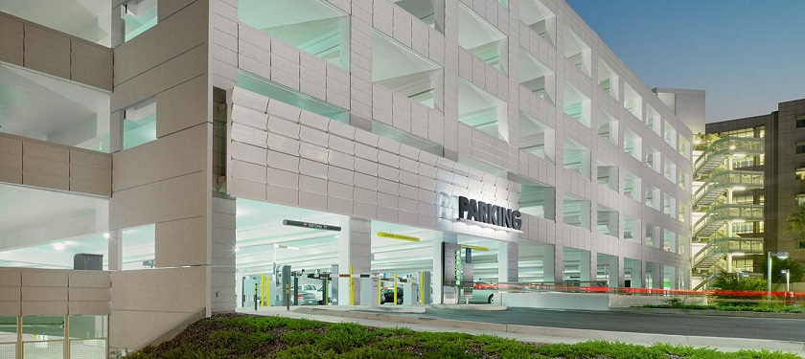
First, we will arrive to the hospital.
We will park our car in the parking garage and go inside.
© 2024 The Regents of the University of California, Davis campus. All Rights Reserved. Used with permission.

Slide 6
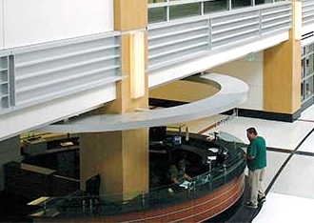
We are going to check in at the front desk.
There will be some paperwork for my grown up to do.
© 2024 The Regents of the University of California, Davis campus. All Rights Reserved. Used with permission.

Slide 7
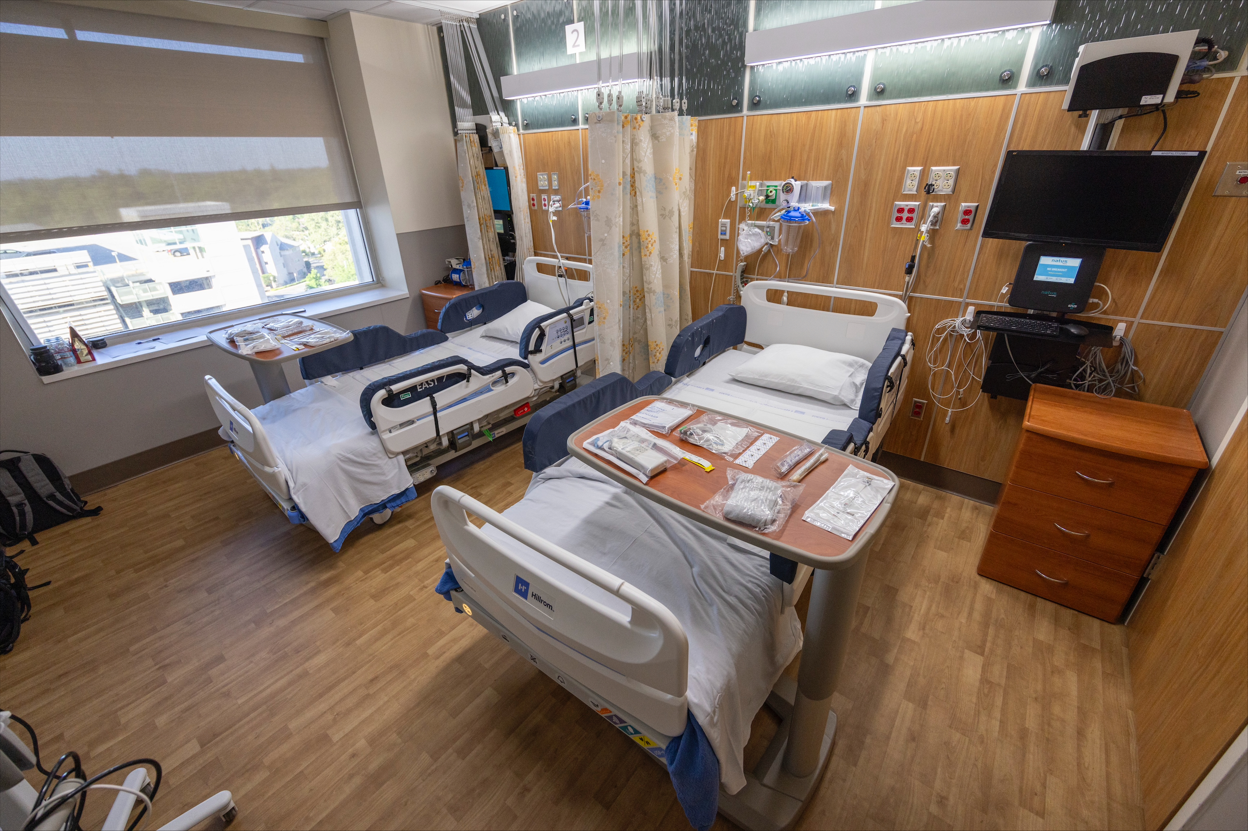
They will call my name, and someone will greet us to take me to my room.
Once I am in my room, I can play with a favorite toy, read a book or talk with my grown up while I wait.
© 2024 The Regents of the University of California, Davis campus. All Rights Reserved. Used with permission.

Slide 8
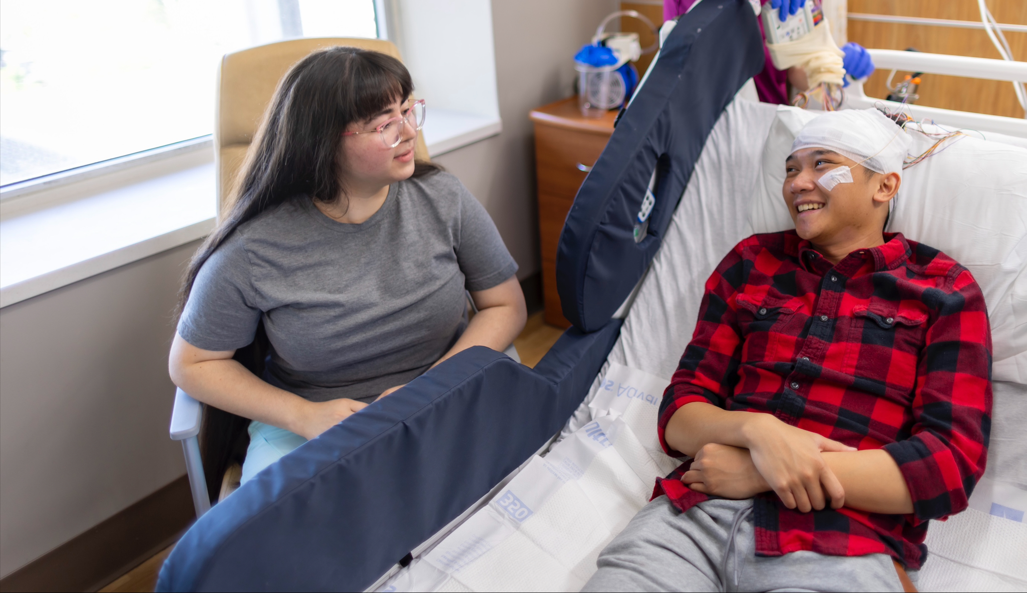
An EEG will not hurt.
But I will need to hold still like a statue while they place the electrodes on my head.
© 2024 The Regents of the University of California, Davis campus. All Rights Reserved. Used with permission.

Slide 9
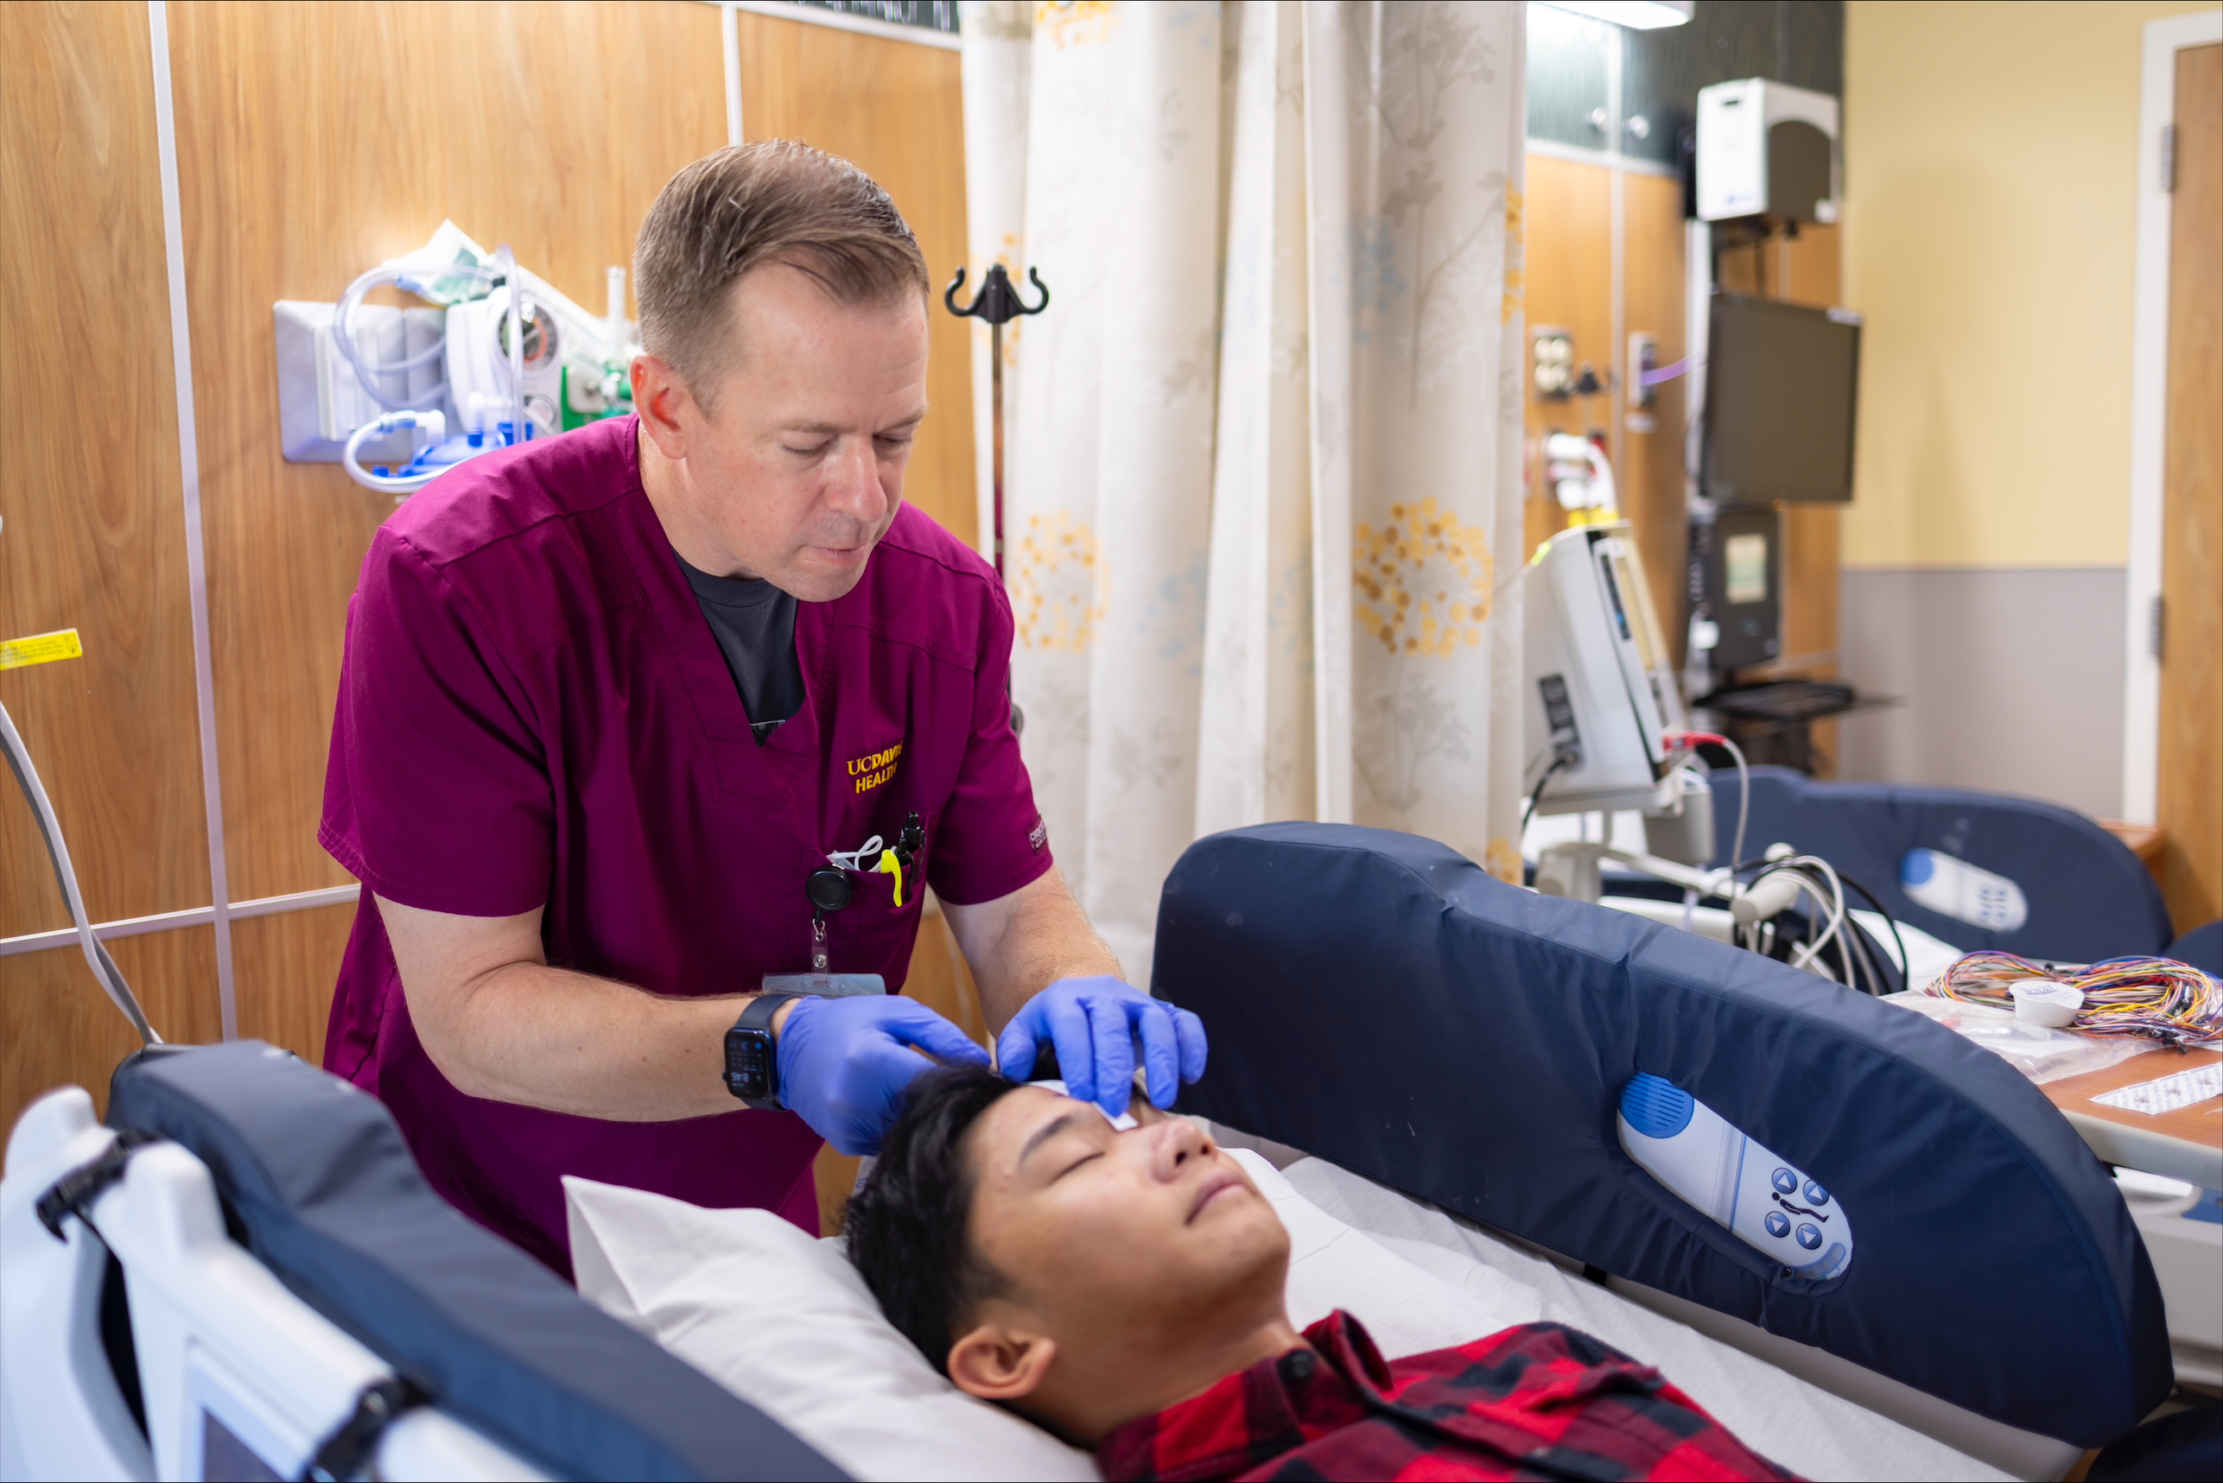
When my tech arrives, they will begin to get me ready for my EEG.
They will measure my head.
© 2024 The Regents of the University of California, Davis campus. All Rights Reserved. Used with permission.

Slide 10
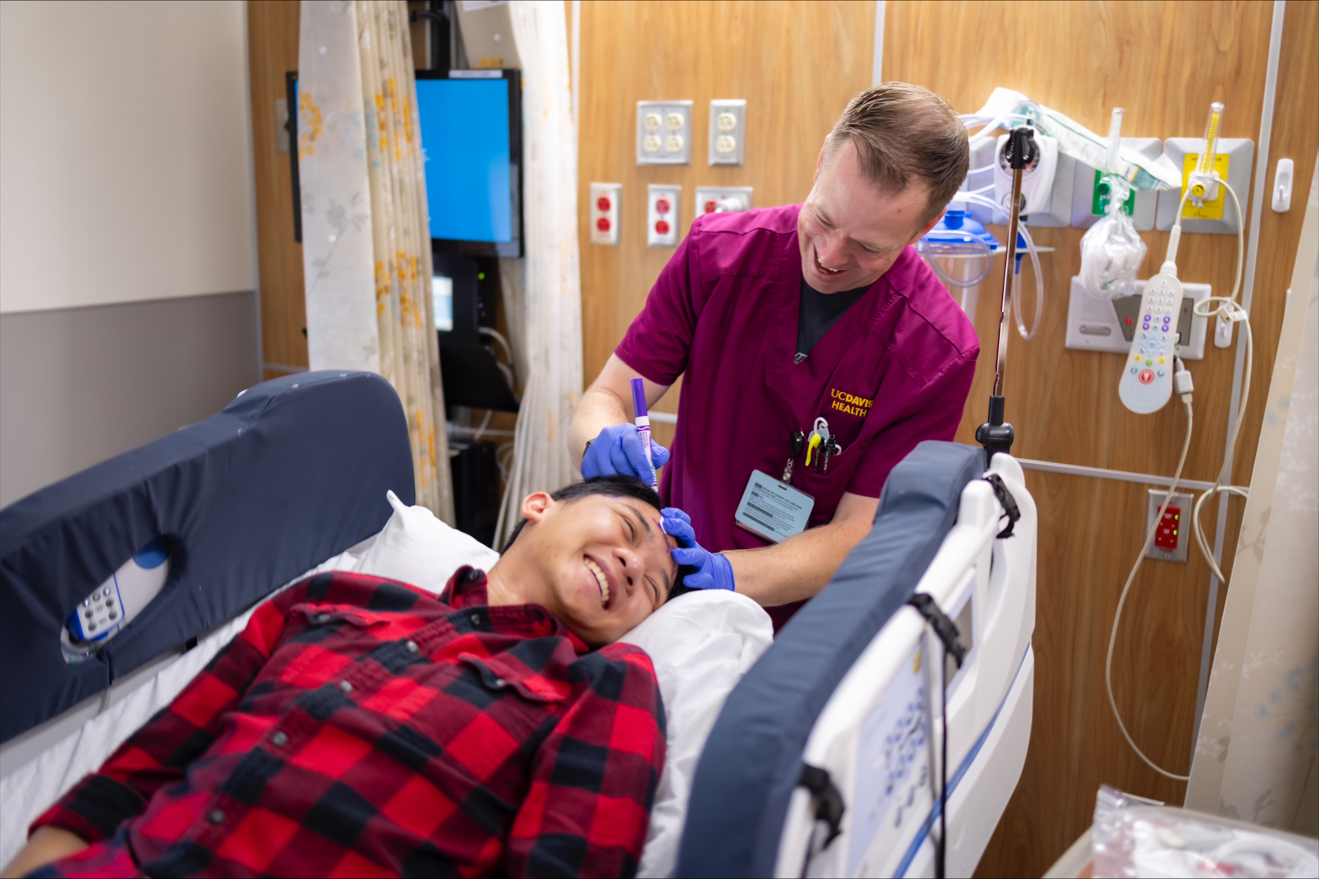
Then they will draw small dots on my head with a marker. This will give the tech a map of where to attach the stickers later.
© 2024 The Regents of the University of California, Davis campus. All Rights Reserved. Used with permission.

Slide 11
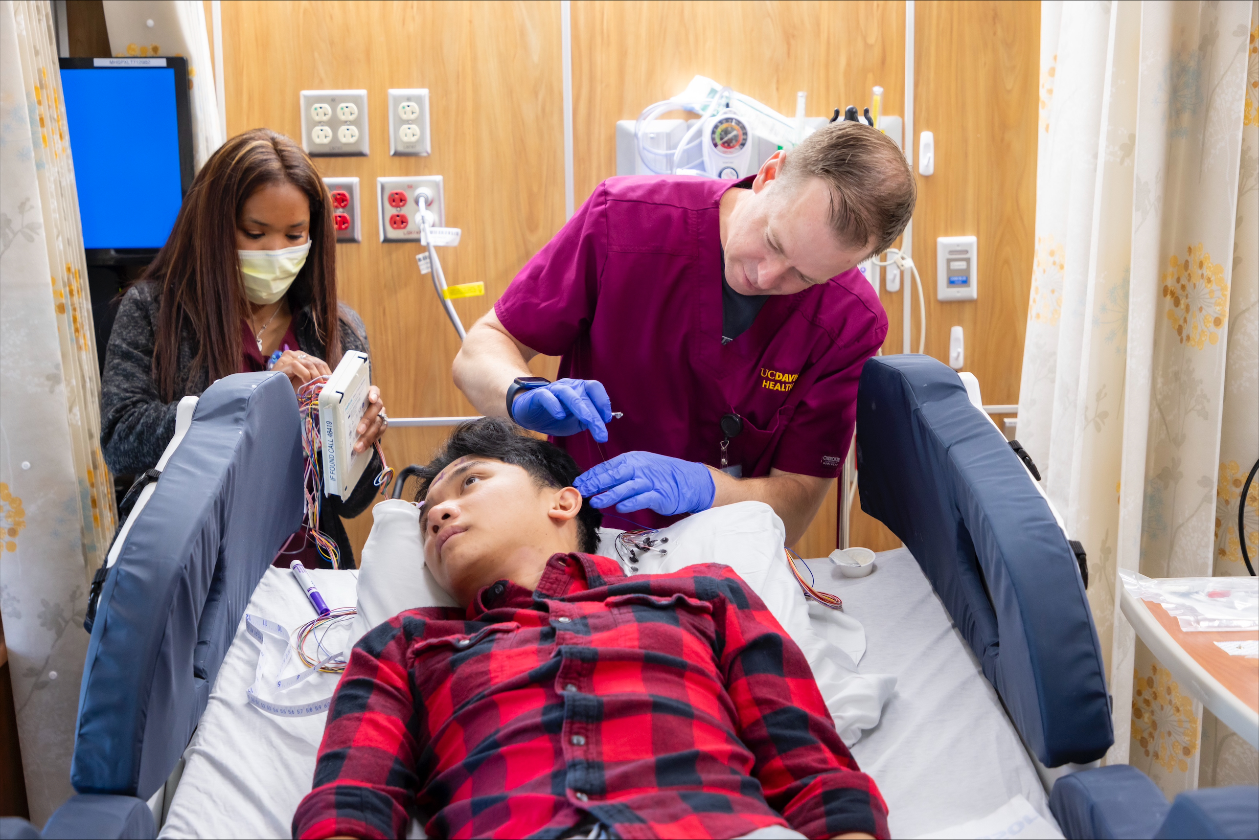
Each mark will be cleaned with a special scrubbing shampoo that feels a little scratchy.
This will help the stickers stay on better.
© 2024 The Regents of the University of California, Davis campus. All Rights Reserved. Used with permission.

Slide 12
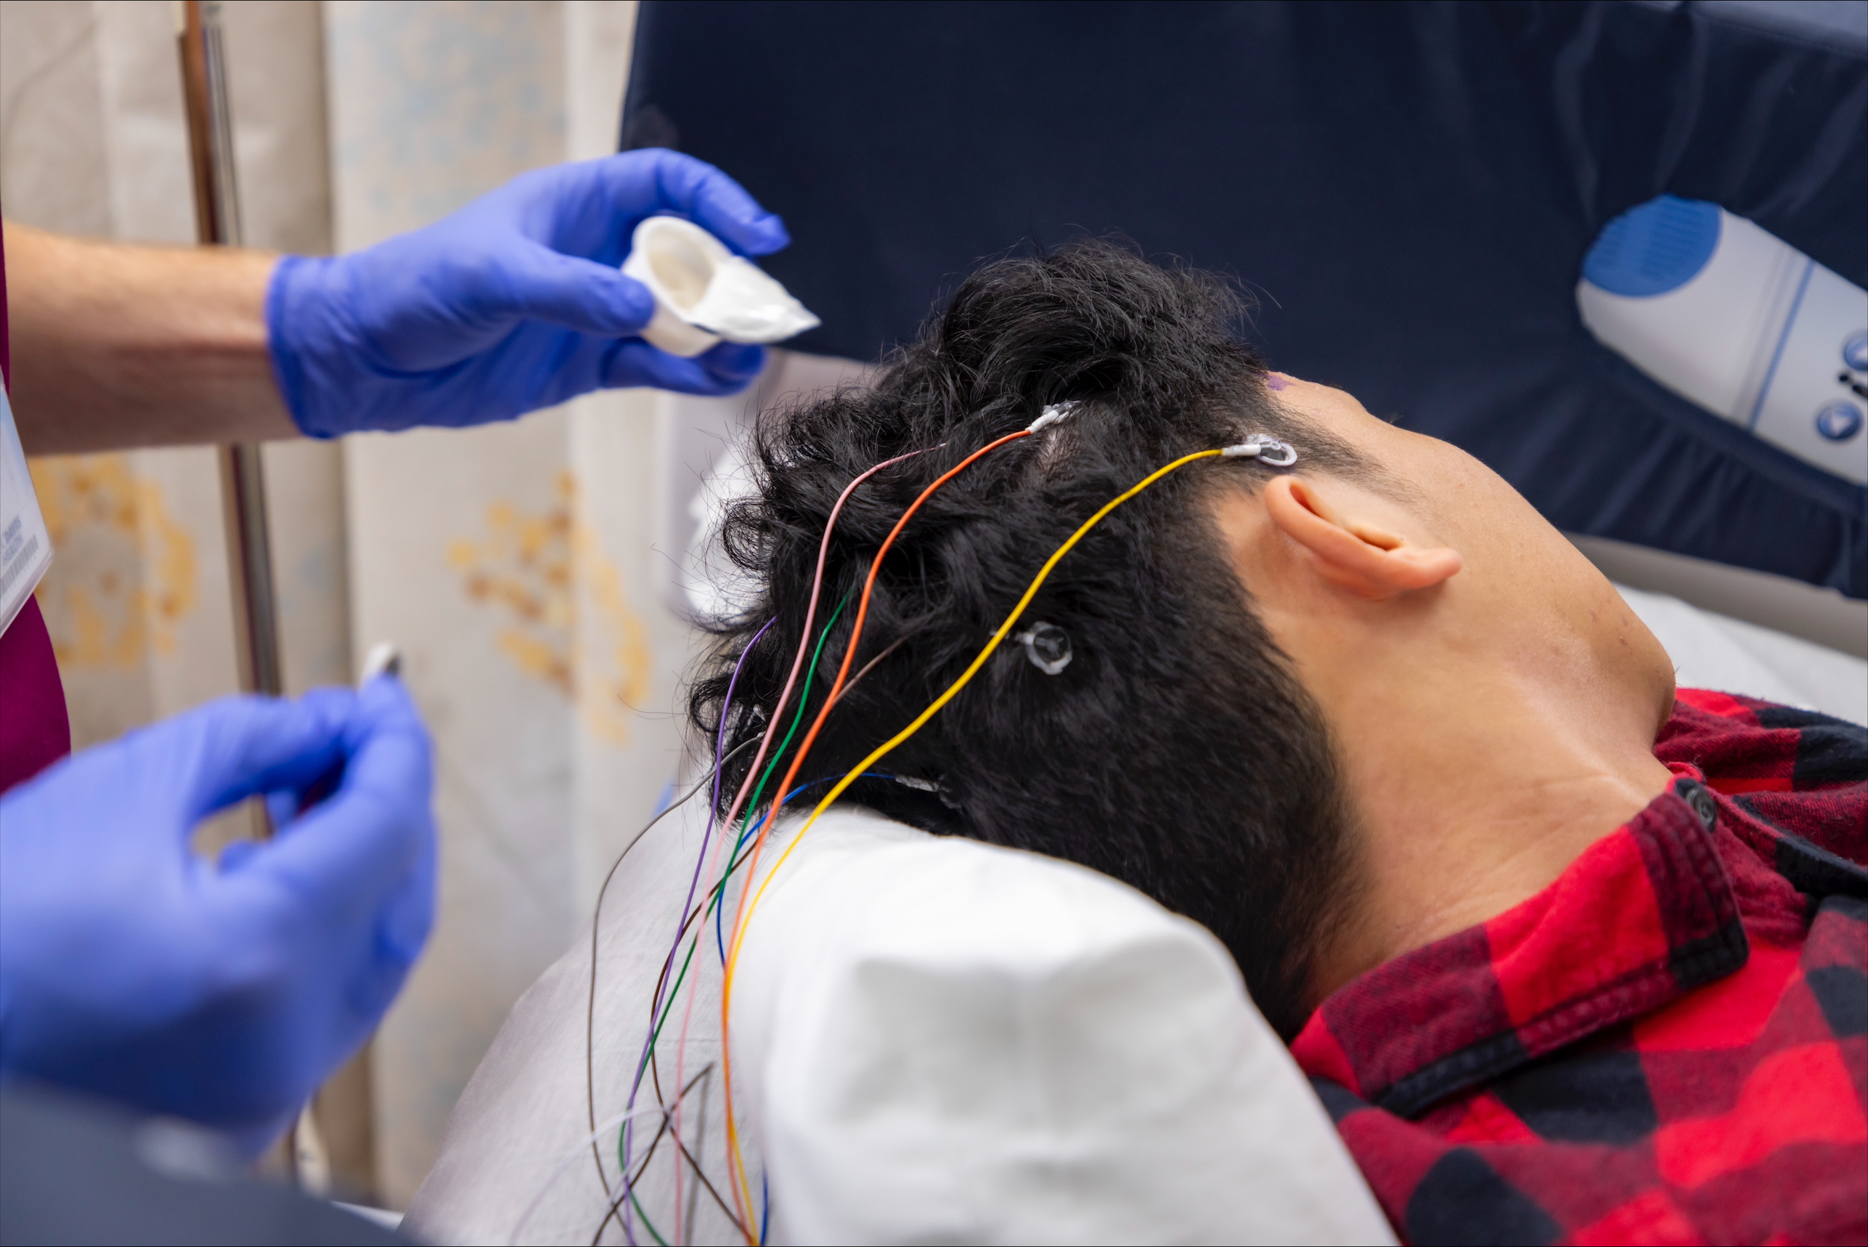
Electrode wires will then be stuck to each spot on my head with glue.
The glue has a strong smell and may feel cool.
© 2024 The Regents of the University of California, Davis campus. All Rights Reserved. Used with permission.

Slide 13
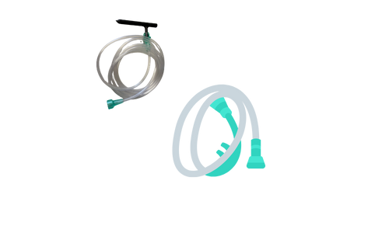
Once the electrodes are on, the tech will use a flexible tube to blow air onto the glue to help it dry.
The air may sound loud like a blow dryer.
© 2024 The Regents of the University of California, Davis campus. All Rights Reserved. Used with permission.

Slide 14
When everything has been applied, the tech will wrap my head with a soft thin fabric.
This will help the electrodes stay in place during the EEG.
© 2024 The Regents of the University of California, Davis campus. All Rights Reserved. Used with permission.

Slide 15
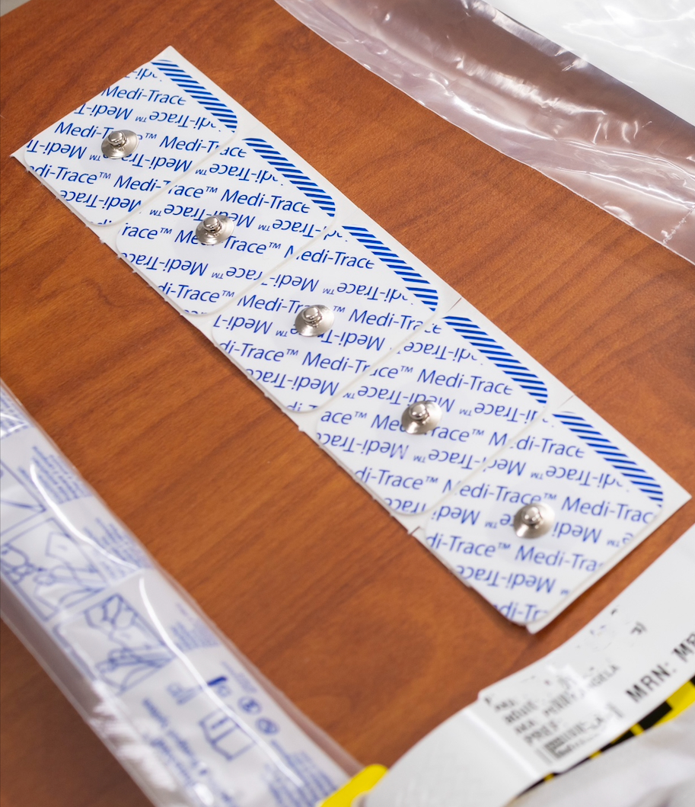
The tech will apply two extra stickers to my chest.
© 2024 The Regents of the University of California, Davis campus. All Rights Reserved. Used with permission.

Slide 16
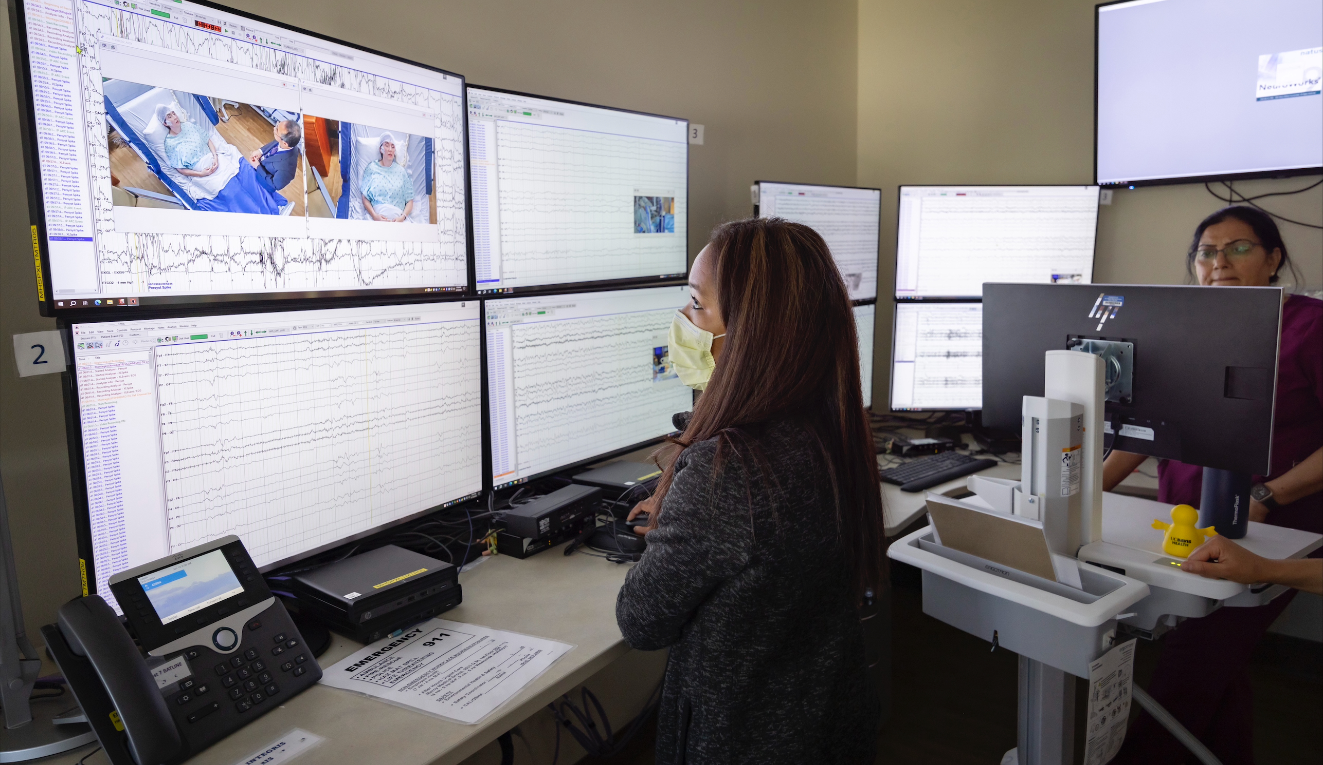
After I am all set up, the tech will test the sensors to make sure everything works properly.
Now my study will begin.
© 2024 The Regents of the University of California, Davis campus. All Rights Reserved. Used with permission.

Slide 17
I will relax and remain still during my study and hospital stay.
I can listen to music or listen to a story being read by my caregiver.
© 2024 The Regents of the University of California, Davis campus. All Rights Reserved. Used with permission.

Slide 18
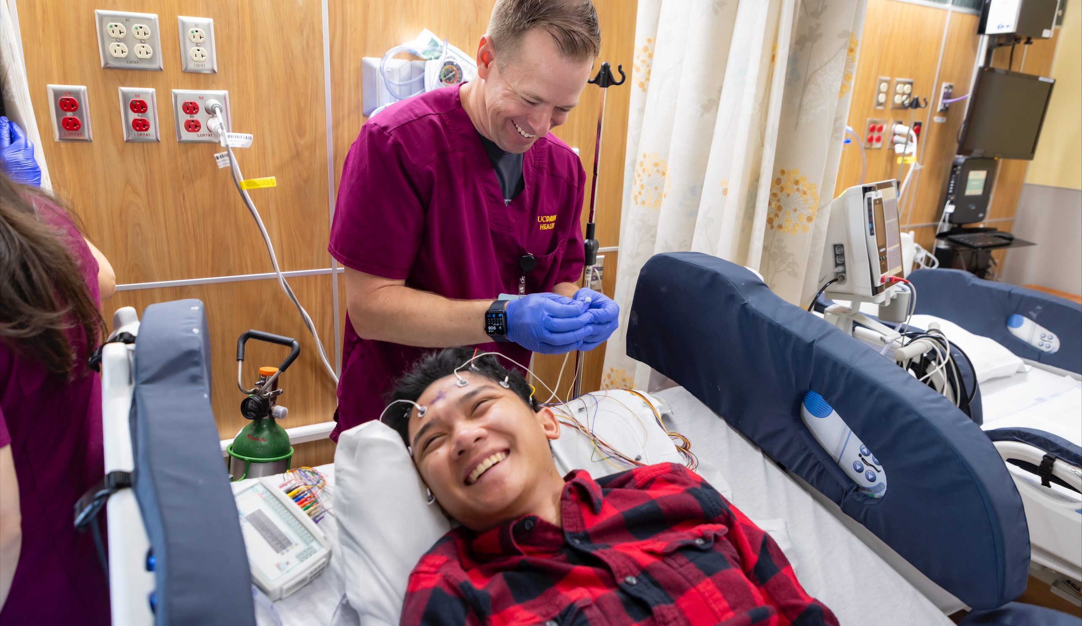
The tech will let me know when the study is complete.
They will remove all of the electrodes and the stickers.
© 2024 The Regents of the University of California, Davis campus. All Rights Reserved. Used with permission.

Slide 19

I am all done with my EEG and can go home.
© 2024 The Regents of the University of California, Davis campus. All Rights Reserved. Used with permission.

