Slide 1


Visiting the Sleep Lab
Social Narrative
© 2024 The Regents of the University of California, Davis campus. All Rights Reserved. Used with permission.

Slide 2

A note to caregivers:
This social narrative has been written to help you and your child prepare for your visit to the UC Davis Sleep Lab.
Social Narratives are clearly written stories that paint a picture of a situation, event or activity. They can be used to increase understanding of a specific situation and help children prepare ahead of time.
This social narrative was written for patients of different ages and language levels. Please use language your child is familiar with at home or when visiting a doctor.
Read this first and choose what information you think will be helpful. Reviewing this with your child before your visit is helpful for many children. However, you may decide that a social narrative is not the best way to prepare your child. You know your child best. If you decide the social narrative provides too much information and your child would do better with a visual schedule, please feel free to use the picture schedule that was also sent to you.
This story will go over the steps of coming to the Sleep Lab to complete a sleep study.
If your child may have difficulty waiting/checking in, please let our team know during your intake call so our team can make a plan to support you and your child upon your arrival.
Sincerely,
The UC Davis Health PATH Program Team
© 2024 The Regents of the University of California, Davis campus. All Rights Reserved. Used with permission.

Slide 3
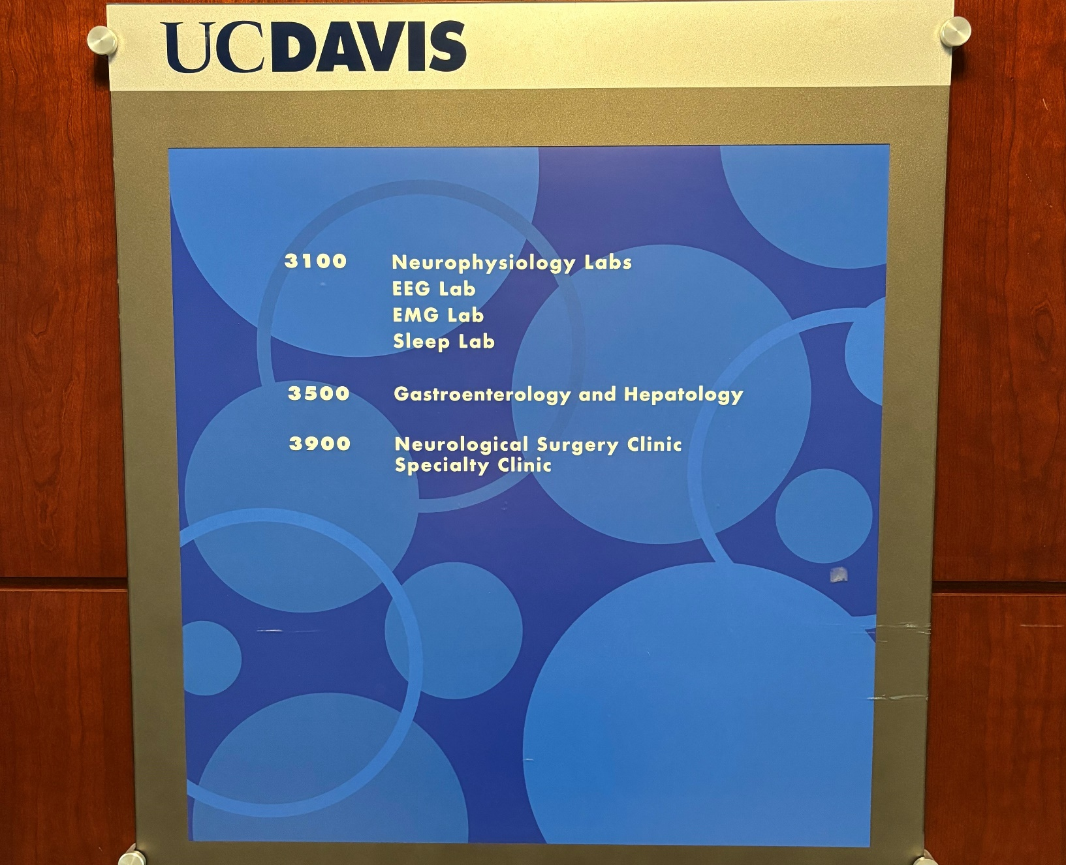
I am going to visit the UC Davis Sleep Lab for a sleep study.
The technologist there will learn more about my brain and breathing while I sleep.
© 2024 The Regents of the University of California, Davis campus. All Rights Reserved. Used with permission.

Slide 4
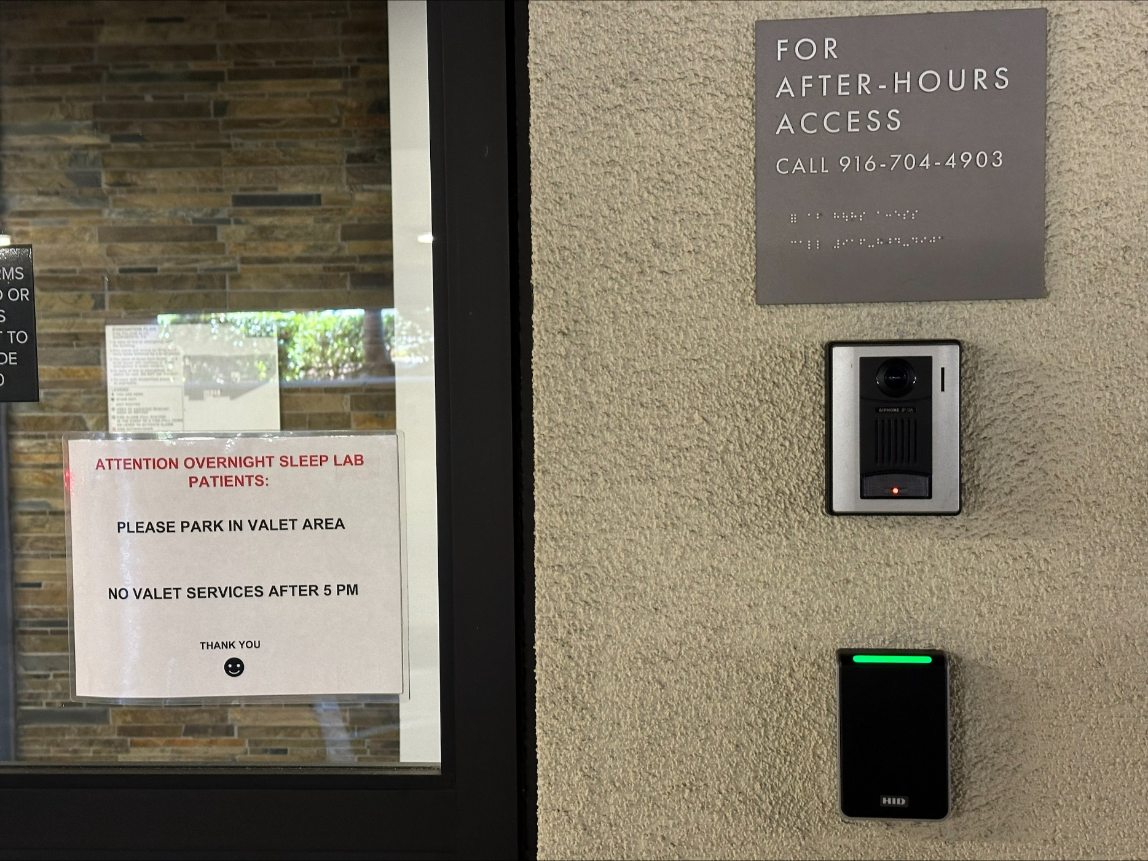
First, I am going to arrive in the parking garage.
We will park our car and use the button to let them know that we are here for our visit.
© 2024 The Regents of the University of California, Davis campus. All Rights Reserved. Used with permission.

Slide 5
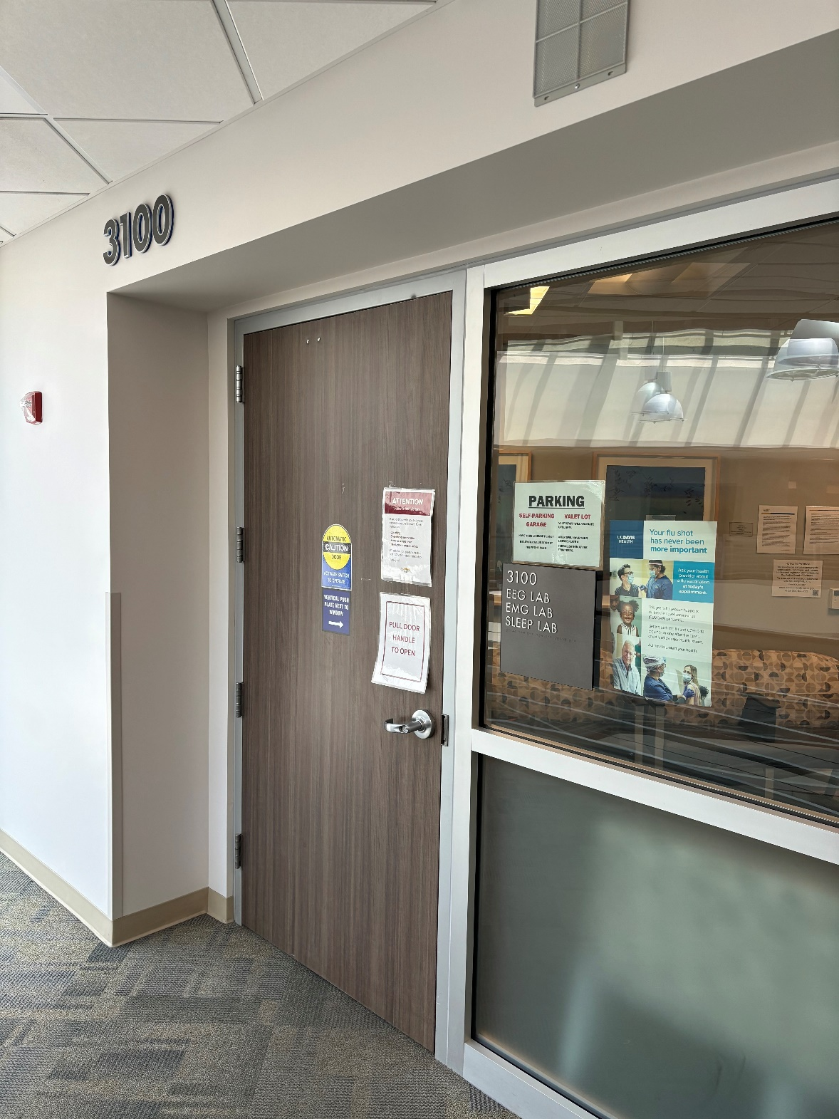
We will ride the elevator to the third floor.
When we arrive, we will enter the Sleep Lab in Suite 3100.
© 2024 The Regents of the University of California, Davis campus. All Rights Reserved. Used with permission.

Slide 6
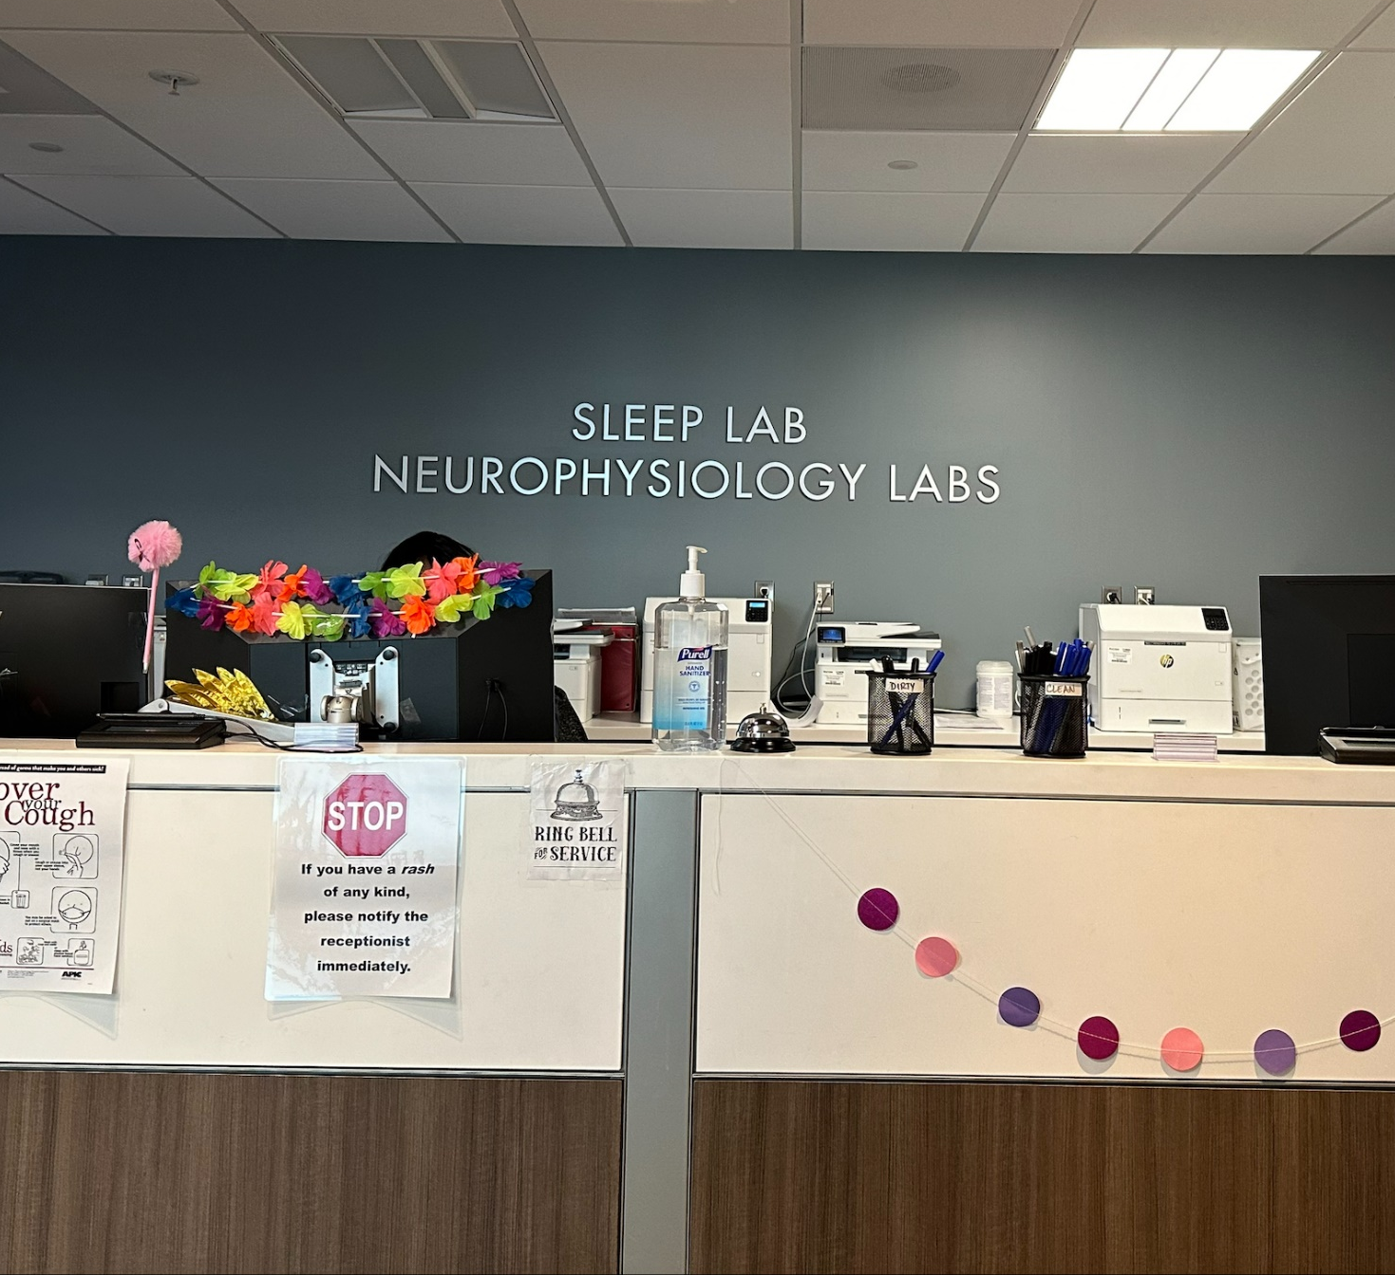
We are going to check in at the front desk.
There will be some paperwork for my grown up to do.
© 2024 The Regents of the University of California, Davis campus. All Rights Reserved. Used with permission.

Slide 7

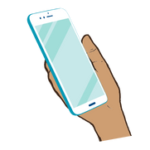
Next, I will wait for my name to be called.
I can play with a favorite toy, read a book or talk with my grown up while I wait.
© 2024 The Regents of the University of California, Davis campus. All Rights Reserved. Used with permission.

Slide 8
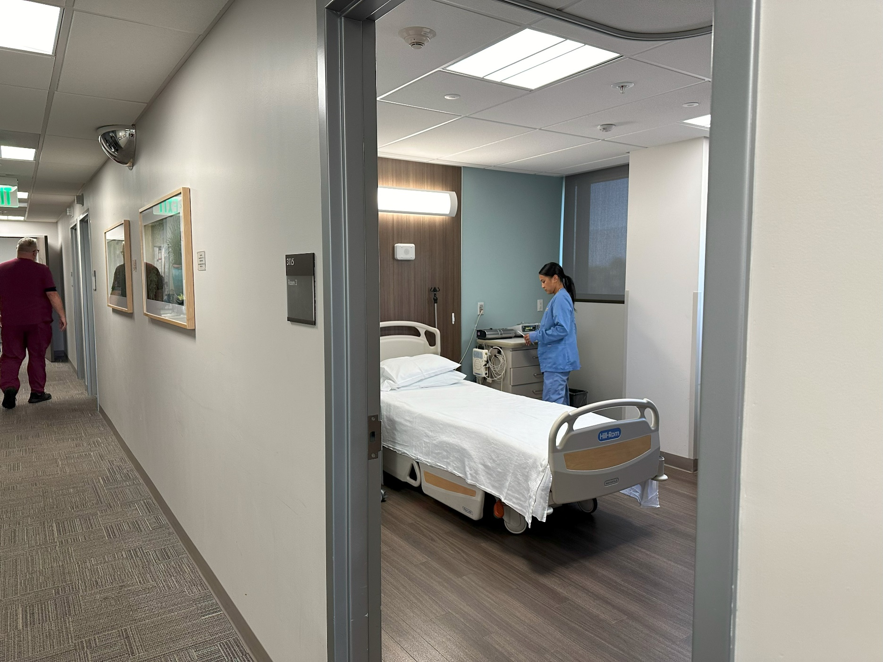
When my name is called, I will meet my tech.
They will show me to my room and give us a tour of the sleep lab.
© 2024 The Regents of the University of California, Davis campus. All Rights Reserved. Used with permission.

Slide 9
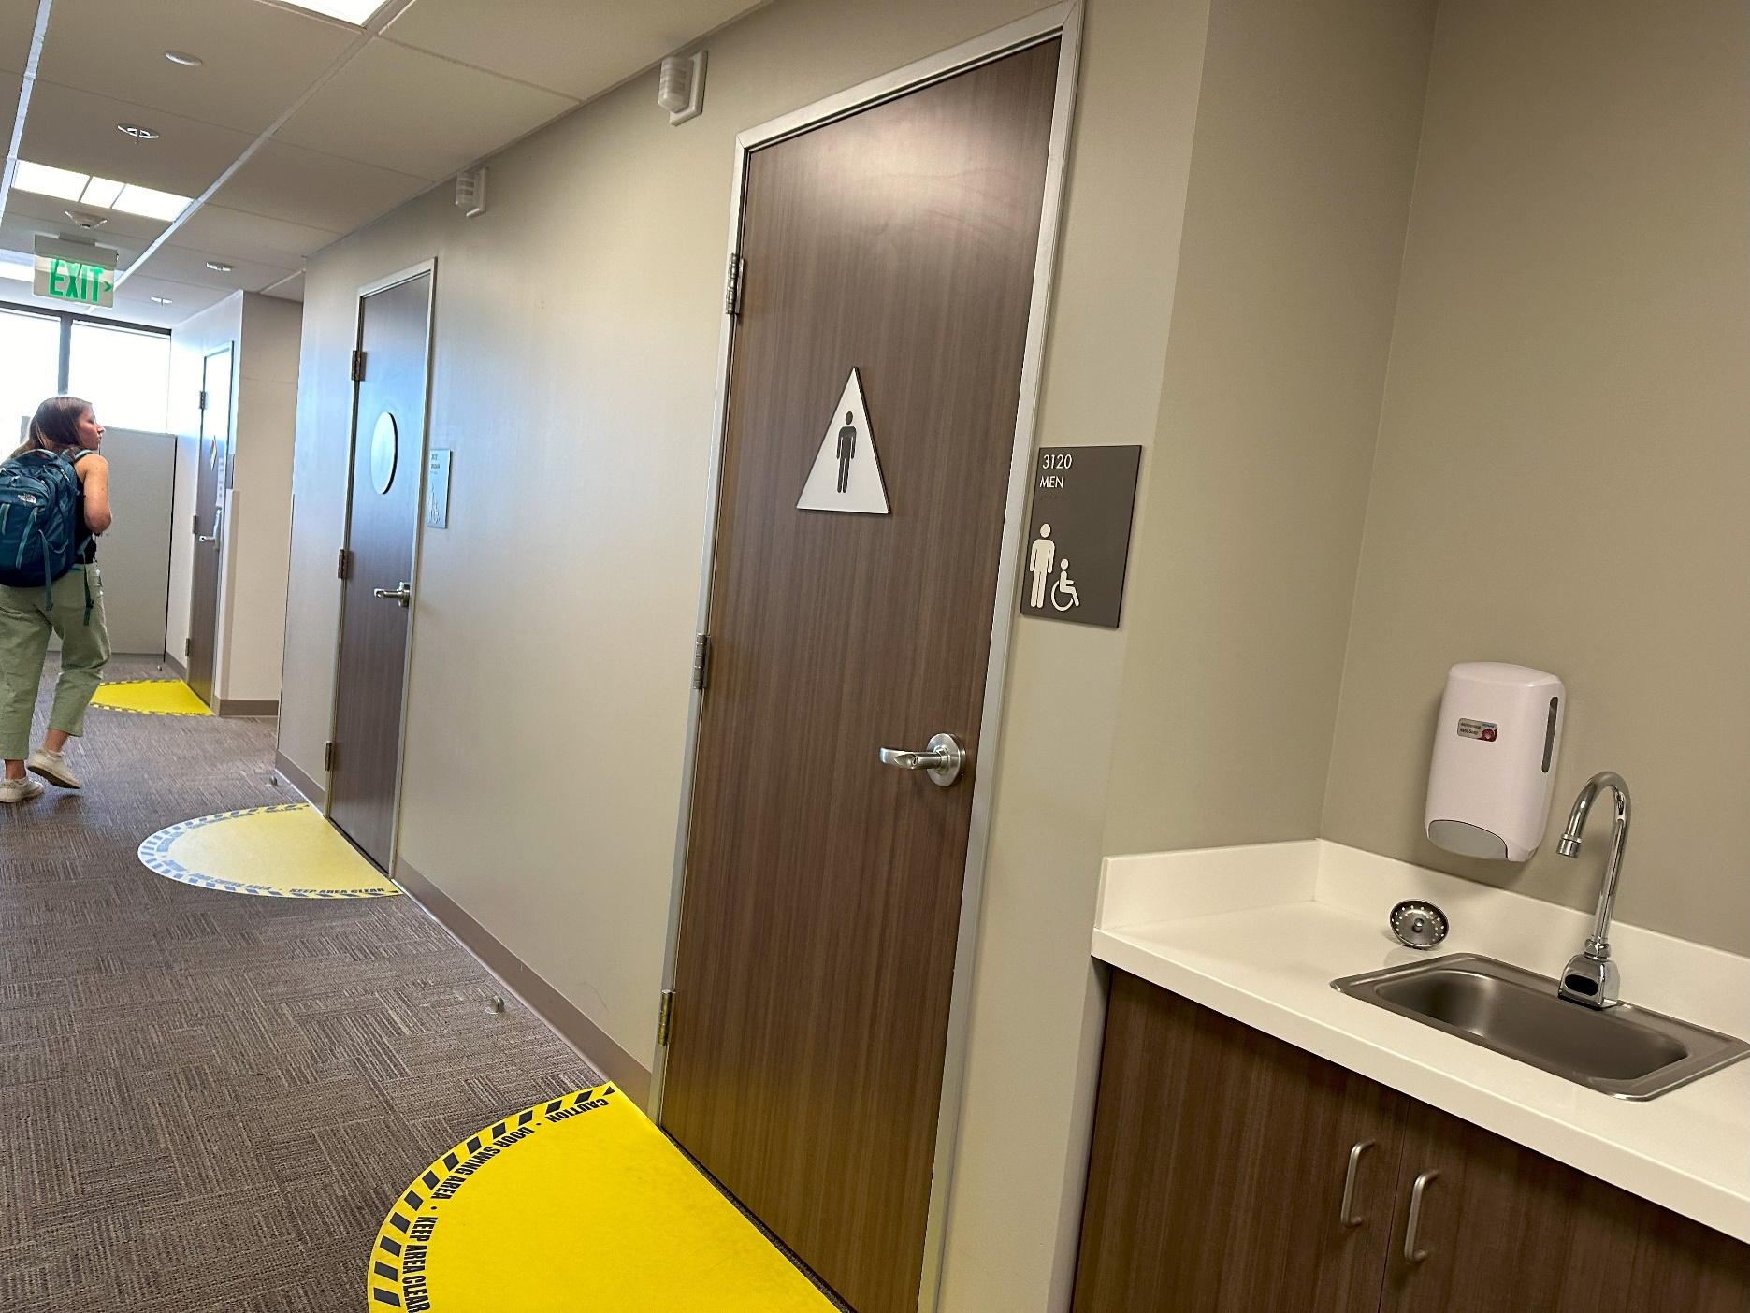
They will show me where the bathrooms are.
© 2024 The Regents of the University of California, Davis campus. All Rights Reserved. Used with permission.

Slide 10
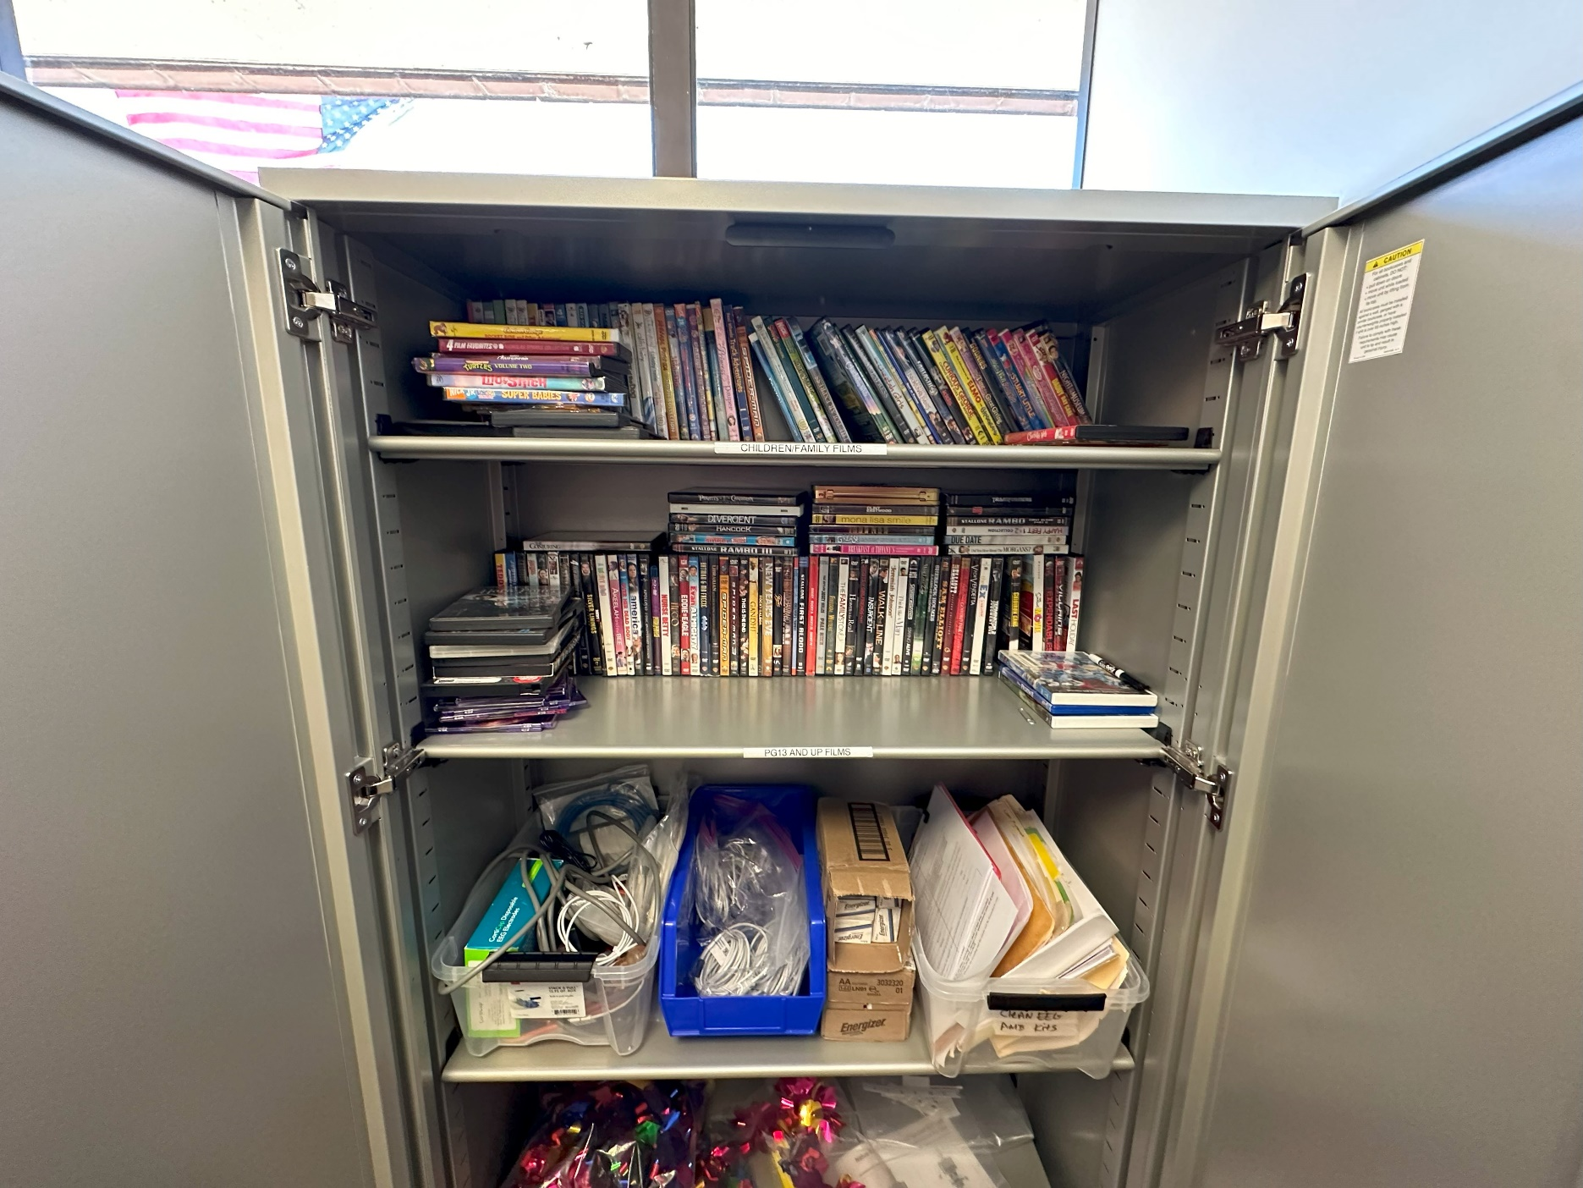
They will also show me the movie cabinet. Here, I can choose a movie to watch in my room.
© 2024 The Regents of the University of California, Davis campus. All Rights Reserved. Used with permission.

Slide 11
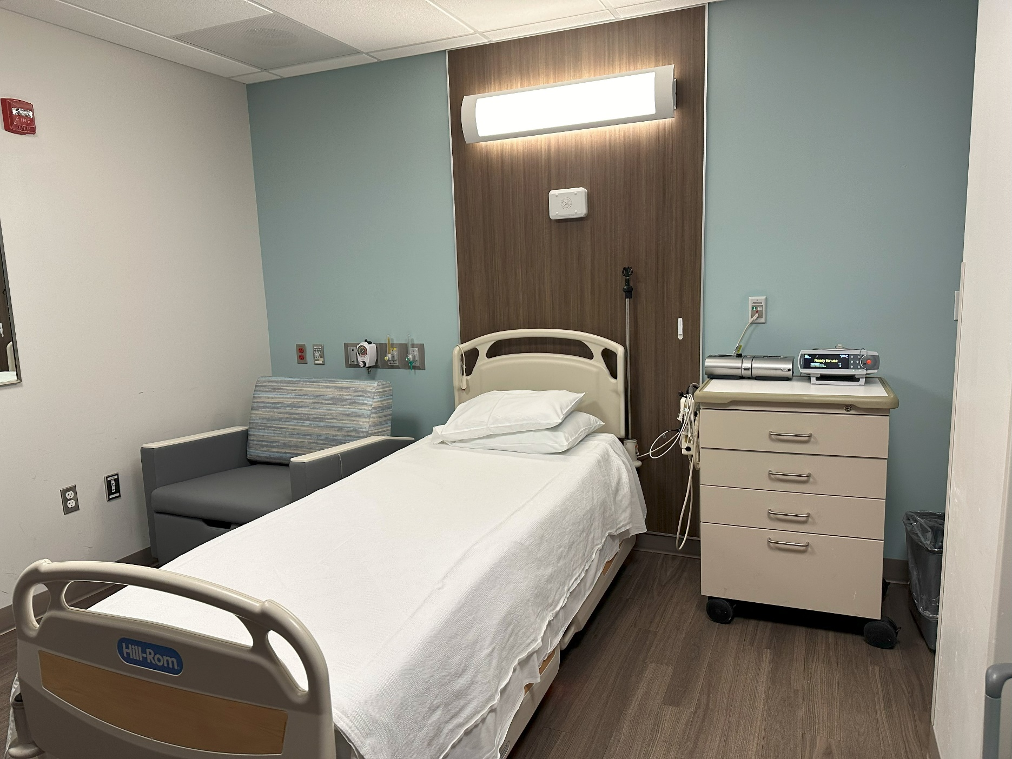
Once I am in my room, they will tell me what I can expect for the evening.
I will change into my pajamas and get ready for bed.
© 2024 The Regents of the University of California, Davis campus. All Rights Reserved. Used with permission.

Slide 12
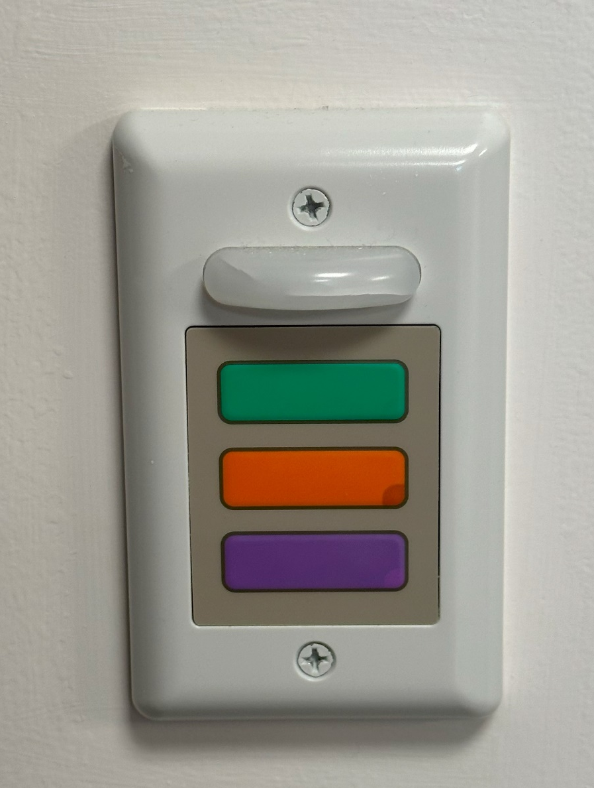
Once I am ready for bed, I can press the call light button.
This will tell my tech that I am ready for my sleep study, and they will come to set me up.
© 2024 The Regents of the University of California, Davis campus. All Rights Reserved. Used with permission.

Slide 13
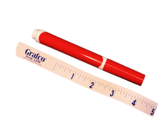
They will measure my head.
Then they will draw small dots on my head with a marker. This will give the tech a map of where to attach the stickers later.
© 2024 The Regents of the University of California, Davis campus. All Rights Reserved. Used with permission.

Slide 14
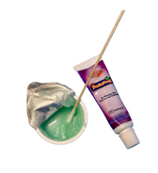
Each mark will be cleaned with a special scrubbing gel that feels a little scratchy.
This will help the stickers stay on better.
© 2024 The Regents of the University of California, Davis campus. All Rights Reserved. Used with permission.

Slide 15
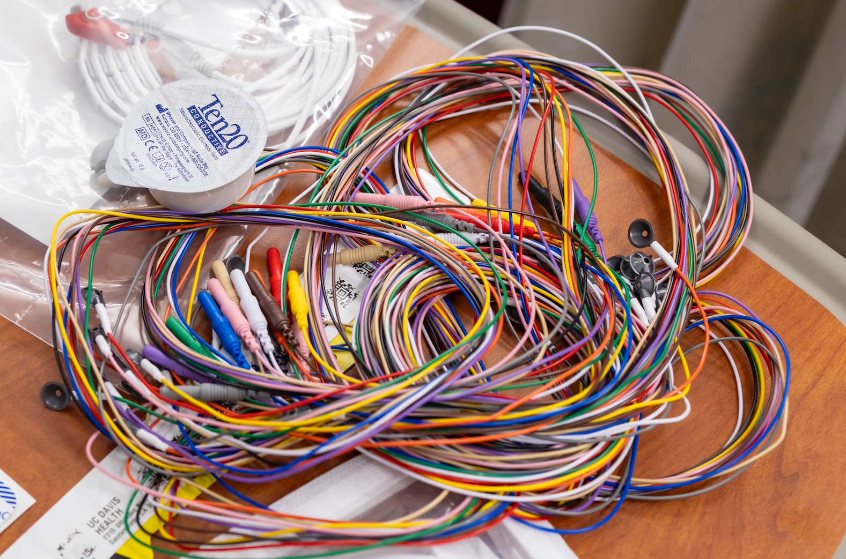
Electrode wires will then be stuck to each spot on my head with a thick paste.
The paste is thick like toothpaste.
© 2024 The Regents of the University of California, Davis campus. All Rights Reserved. Used with permission.

Slide 16

Once the electrodes are on, the tech will wrap my head with a soft thin fabric.
This will help the electrodes stay in place while I sleep.
© 2024 The Regents of the University of California, Davis campus. All Rights Reserved. Used with permission.

Slide 17
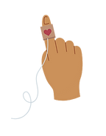

The tech will apply a few extra stickers, one to my chest and one around my finger.
These will monitor my heart rate and oxygen levels.
© 2024 The Regents of the University of California, Davis campus. All Rights Reserved. Used with permission.

Slide 18
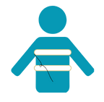
I will also wear two soft bands.
One will wrap around my chest, and one will wrap around my abdomen.
These bands have sensors on them that will help my tech learn about my breathing.
© 2024 The Regents of the University of California, Davis campus. All Rights Reserved. Used with permission.

Slide 19
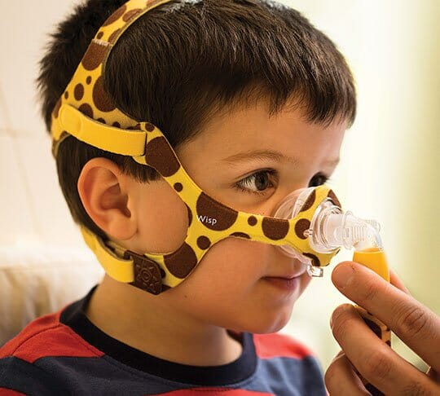
I will wear a soft mask called a “CPAP” on my face. This mask has a flexible tube that blows air to help me breathe while I sleep.
It will not hurt me. It will be soft and lay gently on my face and over my nose.
© 2024 The Regents of the University of California, Davis campus. All Rights Reserved. Used with permission.

Slide 20
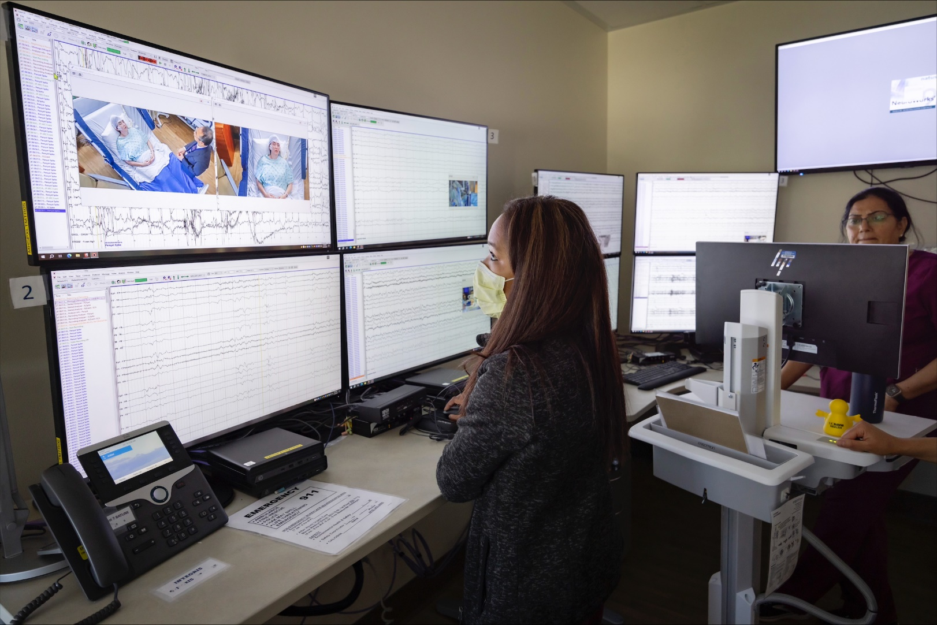
After I am all set up, the tech will test the sensors to make sure everything works properly.
Now my study will begin.
© 2024 The Regents of the University of California, Davis campus. All Rights Reserved. Used with permission.

Slide 21
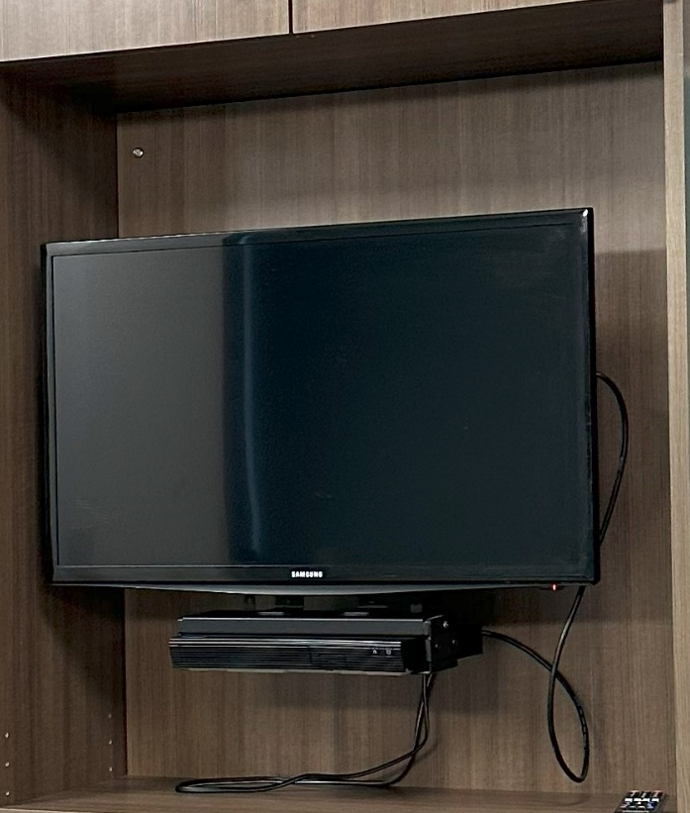
I can choose a quiet activity to do in my room before I go to sleep.
I can read a book, watch a movie, or play with items I brought from home.
© 2024 The Regents of the University of California, Davis campus. All Rights Reserved. Used with permission.

Slide 22
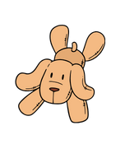
When it’s time for bed, the tech will let us know to turn the lights out.
I can use a special blanket, pillow or comfort item to make it feel more like home.
© 2024 The Regents of the University of California, Davis campus. All Rights Reserved. Used with permission.

Slide 23

My technologist will be able to monitor me through this camera.
© 2024 The Regents of the University of California, Davis campus. All Rights Reserved. Used with permission.

Slide 24
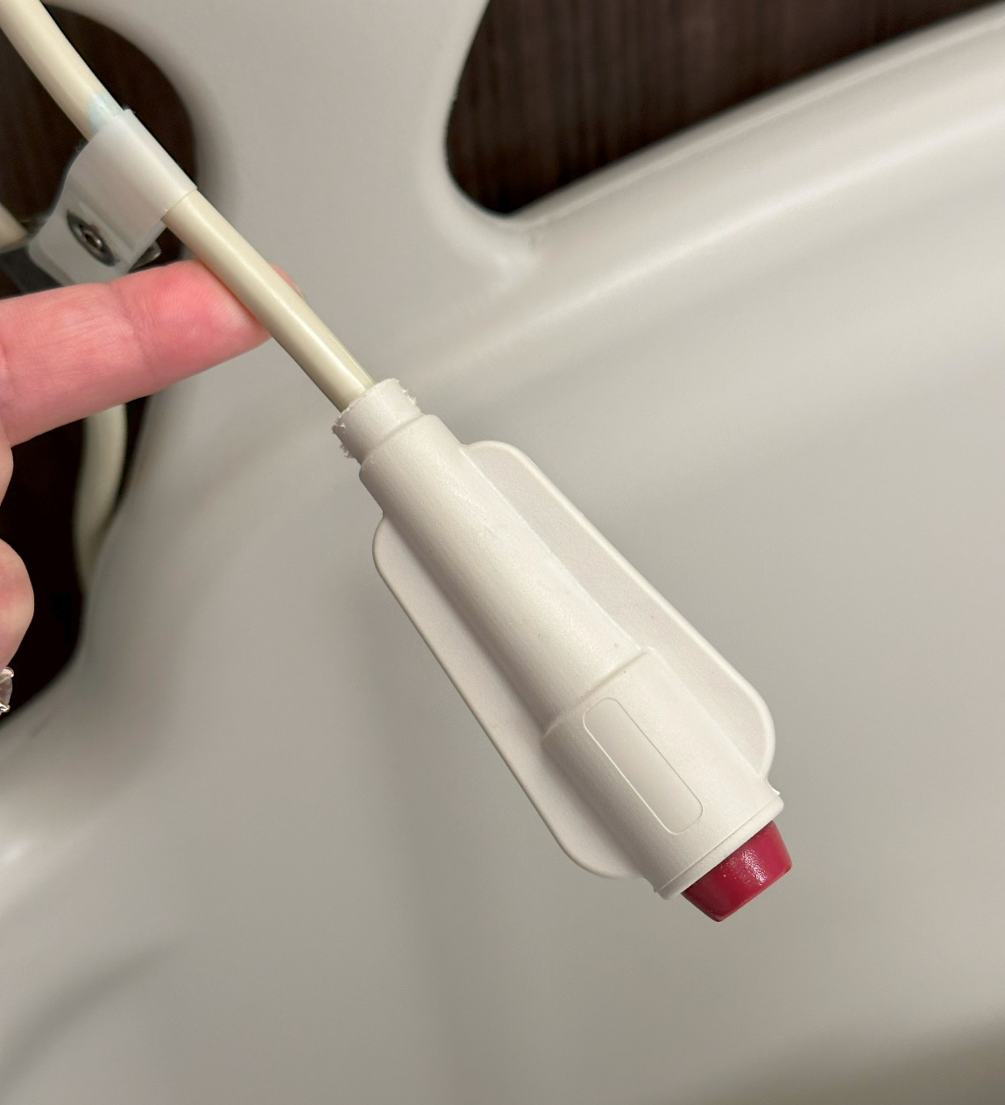
If I need help or assistance, I can call my tech by pressing this red button at any time during the night.
I can find this attached to my bed.
© 2024 The Regents of the University of California, Davis campus. All Rights Reserved. Used with permission.

Slide 25
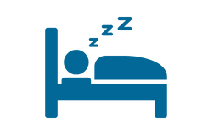
I will lay down in my bed and go to sleep.
© 2024 The Regents of the University of California, Davis campus. All Rights Reserved. Used with permission.

Slide 26
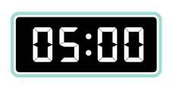
When my sleep study is over, my tech will wake me up at 5:00 a.m.
They will remove all of the electrodes and the stickers.
© 2024 The Regents of the University of California, Davis campus. All Rights Reserved. Used with permission.

Slide 27

I am all done with my sleep study and will go home.
© 2024 The Regents of the University of California, Davis campus. All Rights Reserved. Used with permission.

